Slide 1

Over-Quantization: Investigating Limits and
Error Propagation
Presented by:
D. Mani Kumar Reddy (192325095)
M. Siddartha(192311314)
M. Pranay(192525382)
R. Dinesh (192421117)
P. Likith Reddy (192425134)
Guided by:
Dr. M. J. Carmel Mary Belinda

Slide 2

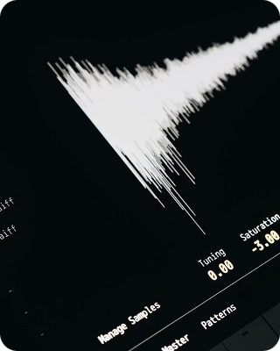
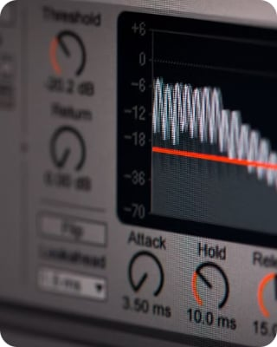
The Quantization Foundation
Process
6 dB Rule
Key Assumption
Mapping continuous signals to finite discrete sets (levels or integers). Core trade-off: precision vs. storage/computation.
Each additional bit ≈ +6.02 dB in SQNR; practical gains diminish with perceptual masking and system noise floors.
Quantization noise modelled as uniform, white, and uncorrelated with input — a simplification that breaks in low-bit or structured systems.

Slide 3

When Assumptions Fail
Many theoretical results assume many quantization bins and small step sizes. In practical low-bit regimes, feedback, predictive coding, and modulators introduce correlation between signal and quantization error, producing patterned distortion rather than white noise.

Slide 4
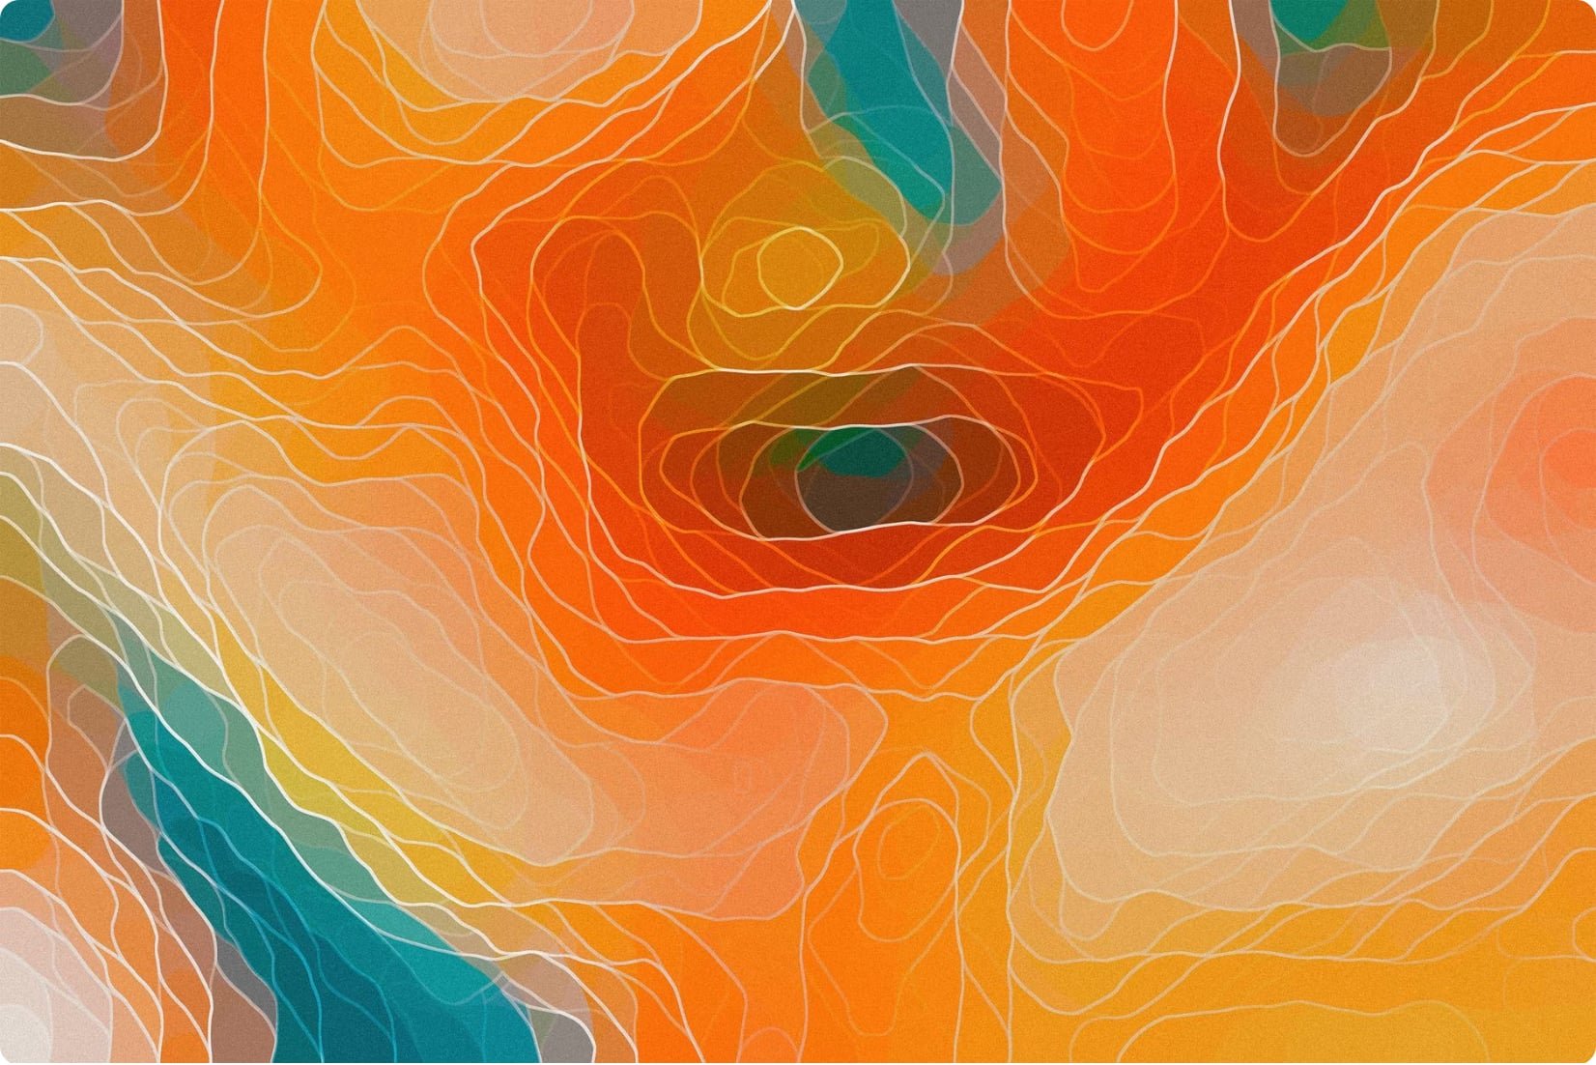
Visualising Information Loss
Low bit-depth creates visible banding (false contouring) as continuous gradations collapse into discrete steps. Reductions in intensity levels force sharp boundaries, losing subtle detail and texture.
Gamut mapping for limited displays/printers further shifts hues and compresses shadow detail, causing detail loss near black points and colour clipping.

Slide 5

The Audio & Signal Threshold
Perceptual Sensitivity
Dynamic Range
Human hearing is logarithmic; companding (μ-law, A-law) allocates bits to preserve low-level detail.
16-bit audio (~98 dB SQNR) usually exceeds environmental noise floors, but processing and resampling can expose quantization artefacts.
Clipping vs Distortion
Analog systems compress gradually; digital clipping produces hard bounds and harmonically-rich distortion that is perceptually intrusive.

Slide 6
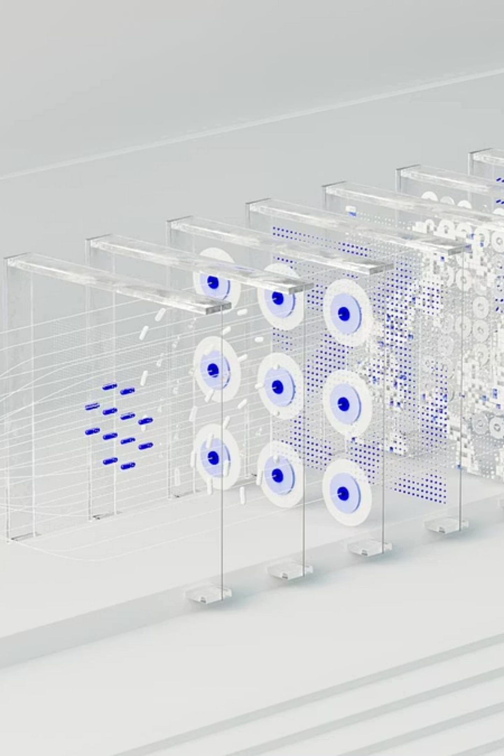
Limitation: Layer-Wise Error Accumulation
Standard post-training quantization treats layers independently. Errors introduced early propagate downstream, interacting with non-linear activations and attention mechanisms — resulting in amplified, structured degradation. In deep transformers, this accumulation often grows near-exponentially.

Slide 7

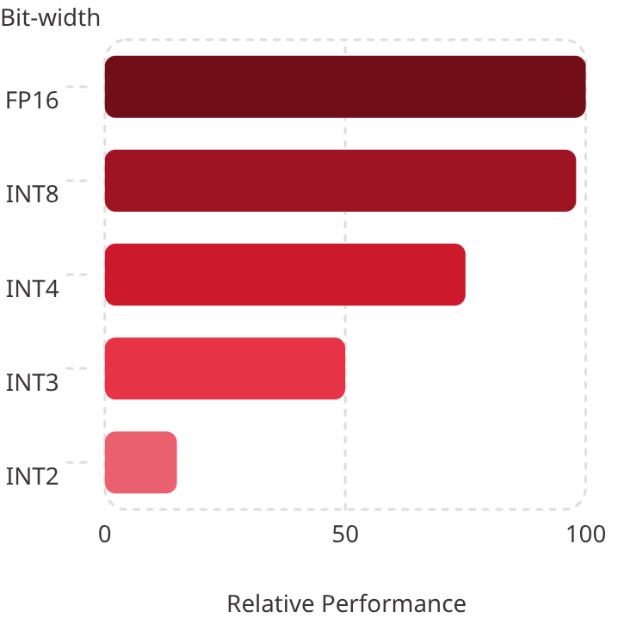
The Scale of Modern Failure
At INT4/INT3, LLMs show severe accuracy loss; INT2 commonly diverges. Layer-wise calibration often overfits to calibration data, reducing robustness on real inputs. These regimes reveal that naive quantization is not robust for modern large models.

Slide 8
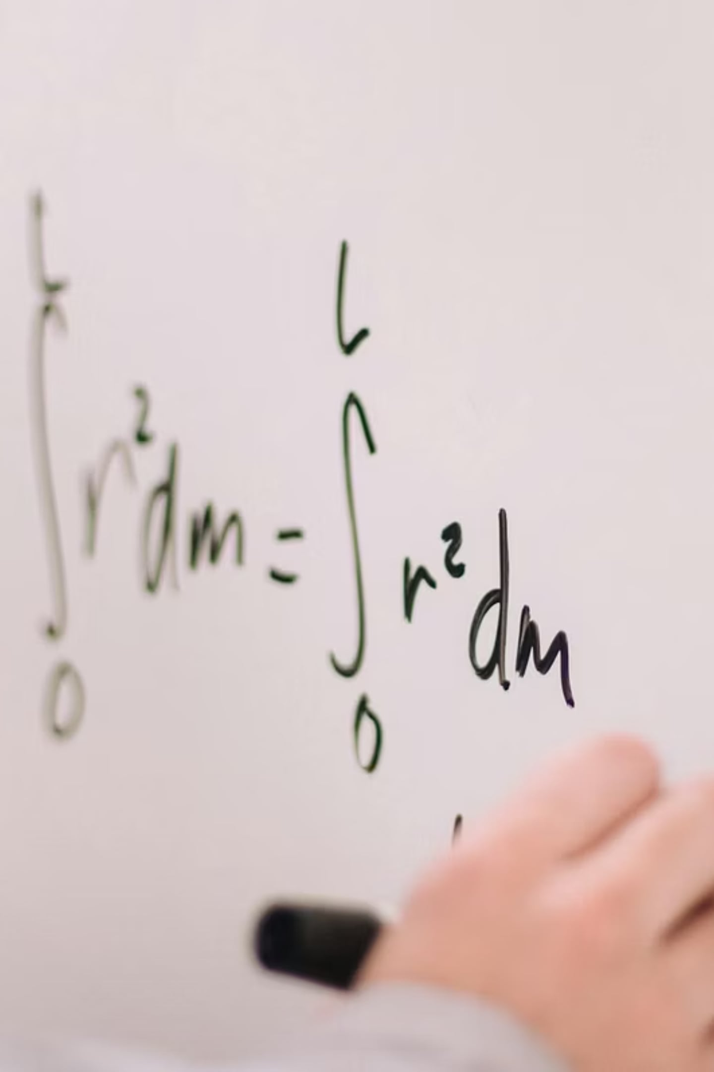
The Solution: Explicit Error Propagation (QEP)
Framework
Quantization Error Propagation (QEP) explicitly tracks upstream errors and inserts corrective terms during layer calibration.
Tunable Strength
Adjustable compensation vs compute trade-off — tuneable to preserve throughput while reducing accumulated distortion.
Compatibility
Designed to integrate with GPTQ, AWQ, QuIP and other PTQ pipelines without disrupting end-to-end deployment.

Slide 9

Prototyping and Performance
Visual demos comparing baseline quantised models versus QEP-enhanced models show reduced error growth and clearer outputs. Benchmarks indicate QEP restores usable accuracy in INT2 regimes where baselines fail.
Restores task accuracy at very low bit-widths
Correction terms are computationally lightweight
Robust across calibration sets — less overfitting

Slide 10

Conclusion: Moving Beyond Uniformity
Recognise Loss
Holistic Calibration
Future Directions
Quantization is inherently lossy — assume structure in errors rather than uniform white noise.
Shift from independent layer optimisation to propagation-aware, system-level calibration.
Adaptive bit-depths, dynamic propagation control, and hybrid correction schemes are promising paths to efficient, high-fidelity deployment.

